Slide 1
Burst c-VEP Based BCI: Optimizing stimulus design for enhanced classification with minimal calibration data and improved user experience Kalou Cabrera Castillos, Simon Ladouce, Ludovic Darmet, Frédéric Dehais

Slide 2
Paradigm

Slide 3
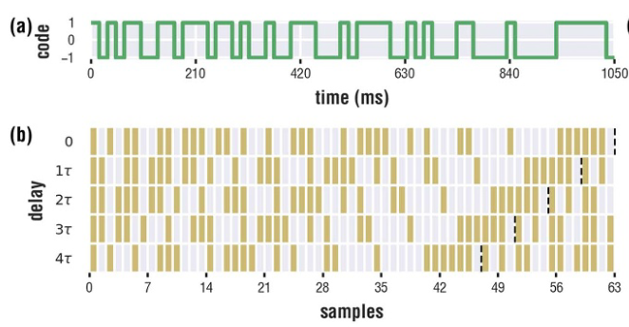
M-sequence design
Mseq is generated with a linear feedback shift registers.
Others are generated by phase shifting
Sequences are uncorrelated between each others
Notes:
Other sequences than M-sequences exist to create the sequence of C-VEP like Gold sequence, Golay sequence or Random sequence. IT is just different function and way of creating the main template.

Slide 4
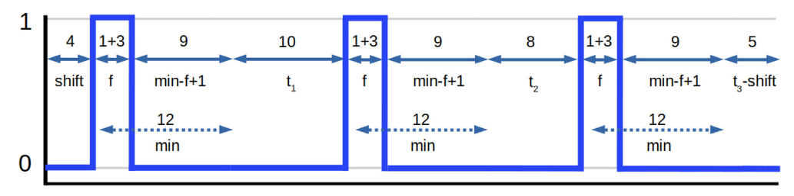
Burst-VEP design
Represented by the tuple (f, min, seq, shift)_R:
f: duration of a burst (ie. Flash)
min: minimal duratio between 2 onset of burst
seq: sequence of the variable part between each burst (ie. [t1,t2….tn])
shift: the phase of the code
R: Screen refresh rate
Notes:
Time between 2 flashes : 200ms < …. < 500ms
After creation, it is circularly shift to the right by 4 frames

Slide 5
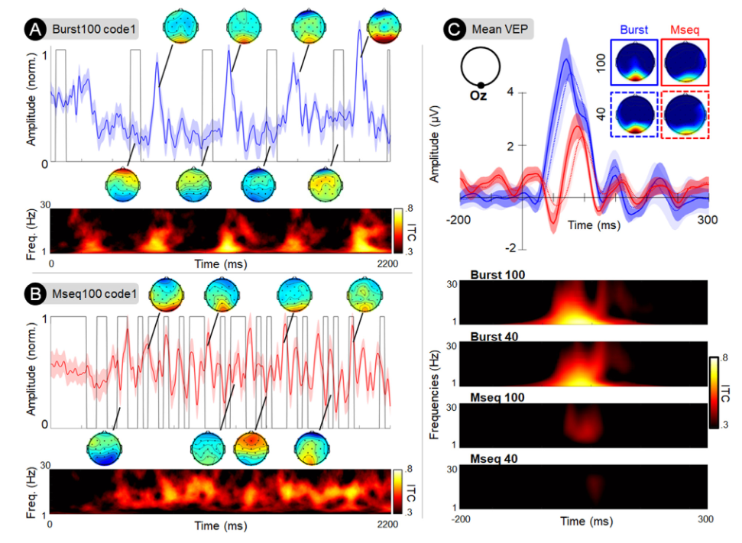
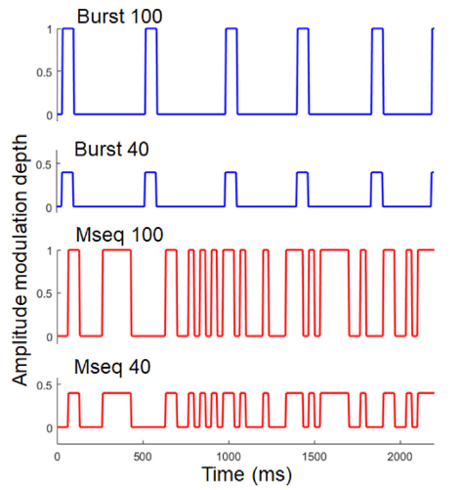
Difference between C-VEP and Burst-VEP

Slide 6
Experiment

Slide 7
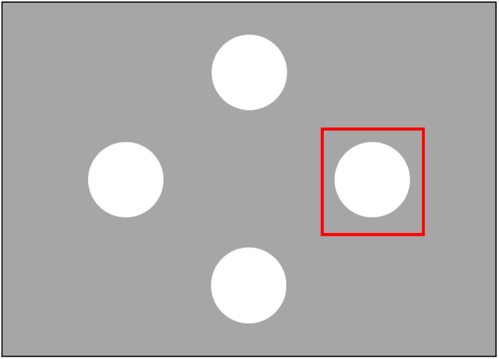
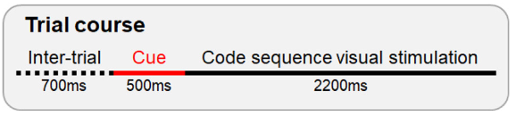
Experiment design
Display design
4 trials by blocks (one per class)
15 blocks per mode
4 modes per session
One session per participant
12 participants
Notes:
2,2*60 = 132 frames per trials
132*4 = 528 frames per blocks
528*4 = 7920 frames per sessions/per participants
Nb_samples (windows epochs = 0,25 ➔ 1,95 used windows stimulation) = 7020 samples per participant
4 women, mean age:30,6 years

Slide 8
Experiment design
4 modes :
M-seq 100% amplitude
M-seq 40% amplitude
Burst-VEP 100% amplitude
Burst-VEP 40% amplitude
3 subjective questions:
Visual comfort
Mental tiredness
Intrusiveness
4 performance criterions:
Classification accuracy
Selection time
Training time
ITR

Slide 9
Classification

Slide 10
CNN
Convolutionnal block
Convolutionnal block
Convolutionnal block
Dense block
Conv2D
Batch normalization
Leaky ReLU
2D Max pooling
Dropout layer

Slide 11
Results

Slide 12
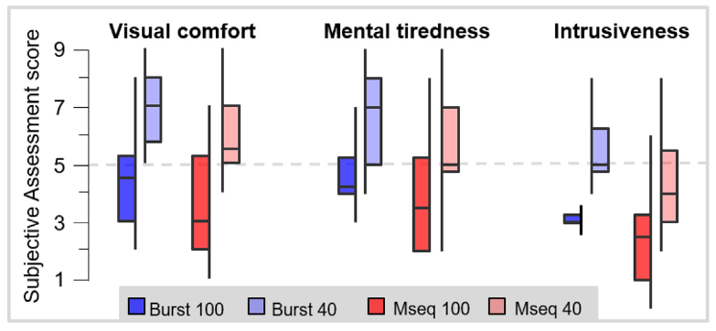
Subjectives Results

Slide 13
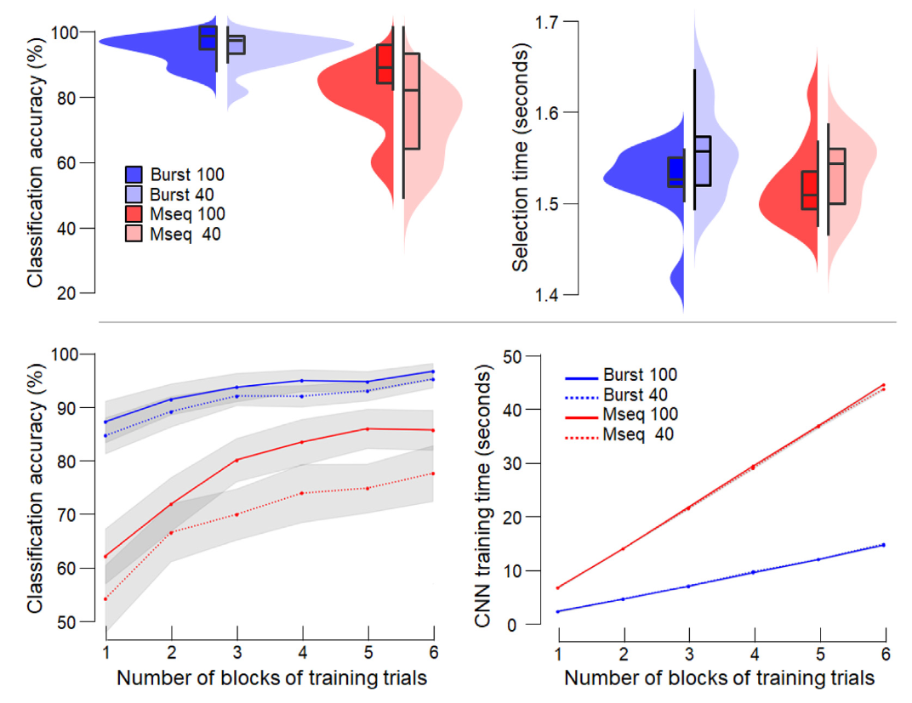
Performance results

Slide 14
About the TSMNet

Slide 15
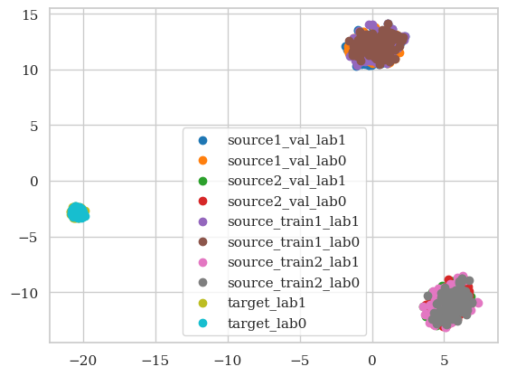
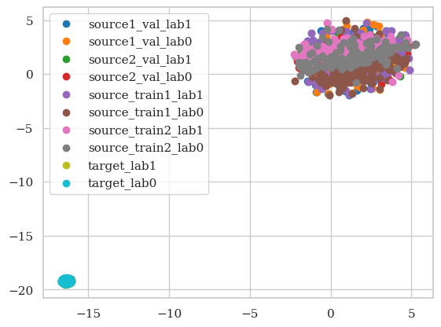
Performance results
Before the DSBN layer
After the DSBN layer

Slide 16
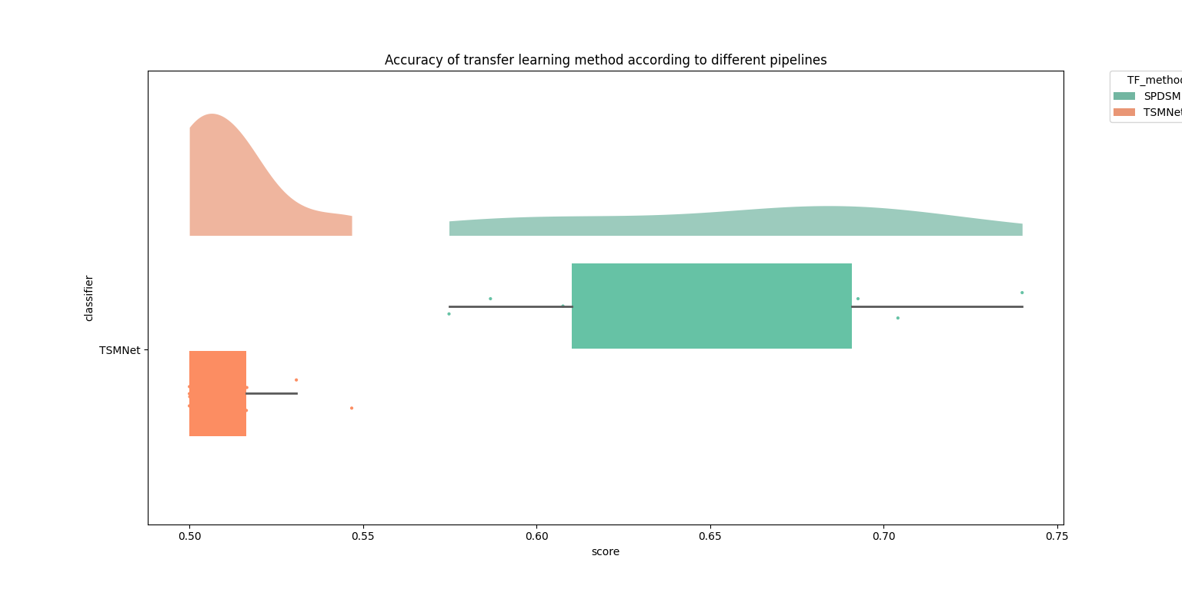
Score TSMnet

